Slide 1
Container Security: Issues, Challenges, and the Road Ahead

Slide 2
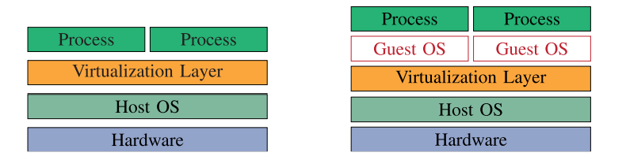
Container vs VM
Container is more lightweight
Container share the same OS kernel
Container is more helpful towards microservice
Container is less secure than VM
Container
b. VM

Slide 3
SECURITY ISSUES OF CONTAINER
Protecting a container from applications inside it
Inter-container protection
Protecting the host from containers
Protecting containers from a malicious or semi-honest host

Slide 4
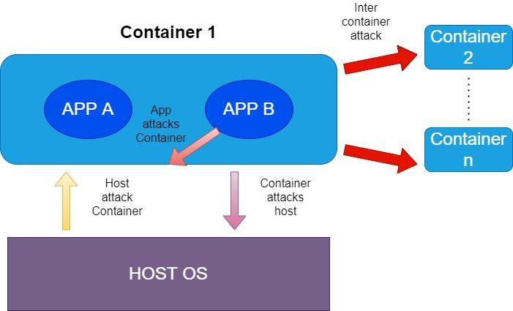
Security Issues of Container

Slide 5
PROTECTION MECHANISM
Software based
Hardware based

Slide 6
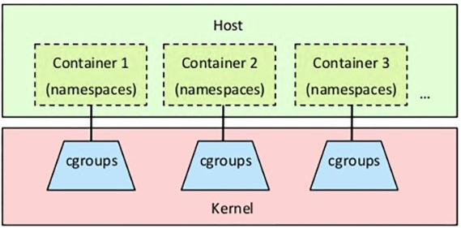
SOFTWARE BASED PROTECTION
LINUX KERNEL FEATURES
Namespace: Isolate resources among containers
Control Groups:Limit resource usages
Capabilities: Prevent access to root privileges
Secure computation mode(SECOMP): Filter out unnecessary system calls from containers.
LINUX SECURITY MODULES

Slide 7
HARDWARE BASED PROTECTION
HARDWARE BASED PROTECTION
HARDWARE BASED PROTECTION
Virtual Trusted Platform Modules(vTPM)
vTPM in host kernel
vTPM in dedicated container
Intel SGX

Slide 8
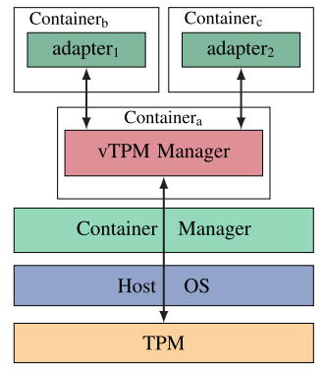
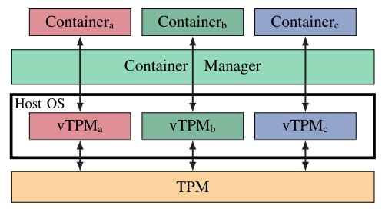
vTPM- VIRTUAL TRUST PLATFORM MODULES
vTPM in HOST kernel(for honest host)
b. vTPM in dedicated container(for semi honest
or malicious host)

Slide 9
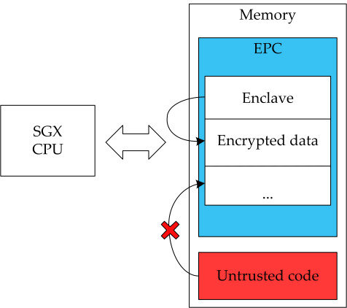
INTEL SGX(SOFTWARE GUARD EXTENSION)
The primary SGX abstraction is enclave: an isolated execution environment within the virtual address space.

Slide 10
OTHER ASPECTS OF SECURITY
Digital forensics for containers
Usability of vulnerability assessment tools
Container alternatives(e.g. unikernel)
Blockchain for container verification
Container specific LSM

Slide 11
THANK YOU

